Slide 1


“Give and Take” Project
Author: Give and Take Team

Slide 2

Research and Develop a mobile application (Give and Take) based on MVVM-Cross framework to runs on both iOS and Android
Final-Report CP2019
Student: Dinh Cong Quoc Tai 14ES
Nguyen Trinh Hung 14ES
Supervisor: Eng. Vo Tat Thanh (Sioux HTS)
Ph.D Huynh Huu Hung (DUT)
M.Sc Ho Viet Viet (DUT)
Author: Give and Take Team

Slide 3
Agenda
A
Introduction
B
Analysis and Design
C
Updating Project Process
D
Theoretical Background
E
Demo
F
Q/A Section
© Sioux 2019 | Confidential
3

Slide 4
A. Introduction

Slide 5

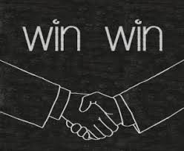
Reason for the project
Bring values to local community.
Bring values to our company in turn and also use it as our Capstone Project.

Slide 6

What is this project about?
A mobile application which connects Givers who are willing to give away useful items with Takers who are in need of those items.
“Give and Take”

Slide 7




Meaning of the logo:

Slide 8

Main Idea
1
2
Individuals or charities send requests
Post items
on the app
3
4
Check and accept requests
Take the items

Slide 9
B. Analysis And Design

Slide 10
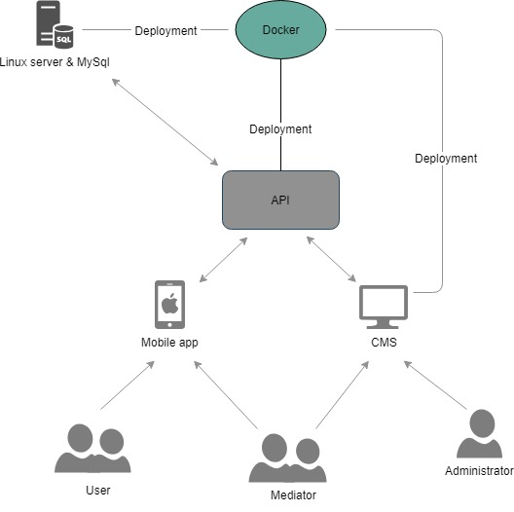
Project Architecture

Slide 11
Login using Facebook account
User’s
User case
Create a post
Create request for another post
Appreciate a post
As an User
Comment on another post
Start conversation with another user
Share post’s content to Facebook
Report another post

Slide 12
Administrator and Mediator
User case
Manage Post
Manage Category
Manage Report
As an administrator
Or mediator
Manage User
Manage mediator
(administrator only)

Slide 13
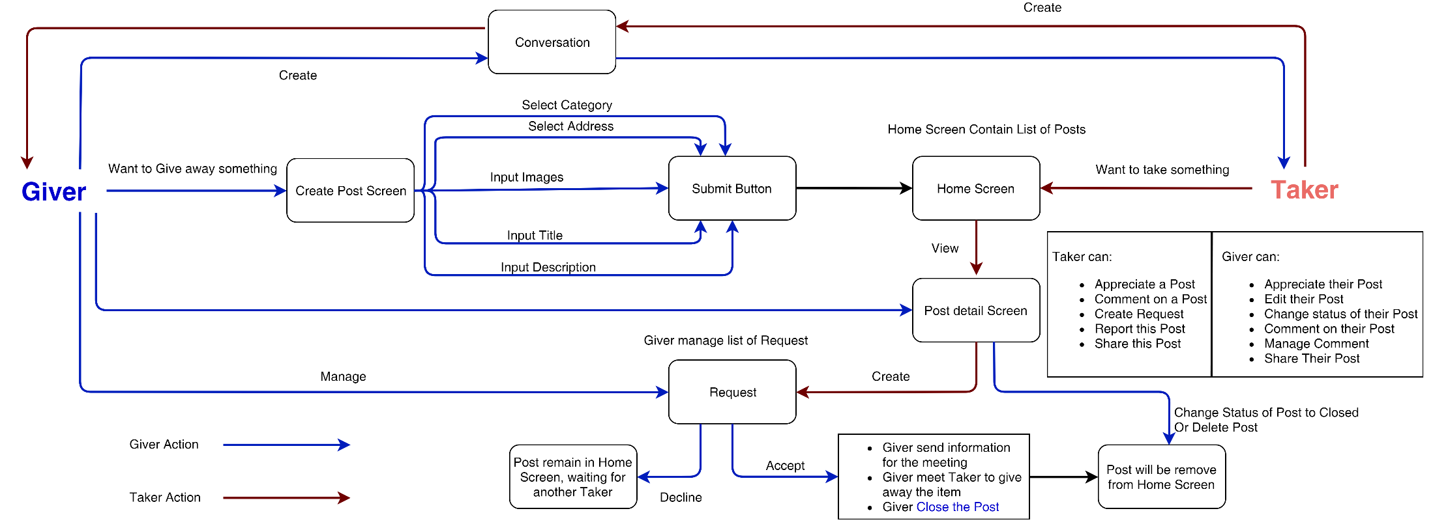
Main Business Process

Slide 14
In This Phase:
Mobile Application
Appreciate a post
Comment on another post
Start conversation with another user
Share post’s content to Facebook
Profile Page
Multiple Languages
CMS Website
Manage Comment
Manage Number of Request, Appreciation
Block or Warning User
Landing page

Slide 15
C. Updating Project Process

Slide 16
No. | Feature | Status | Member
1 | Appreciate a Post | Done | Quoc Tai
2 | Comment | Done | Quoc Tai
3 | Conversation | Done | Quoc Tai
4 | Share Post (App-links) | Done | Quoc Tai, Trinh Hung
5 | Multiple Languages | Done | Quoc Tai, Trinh Hung
6 | Profile view | Done | Quoc Tai
7 | Manage Comment on CMS | Done | Trinh Hung
8 | Display Number of Appreciation (CMS) | Done | Trinh Hung
9 | Manage Request on CMS | Done | Trinh Hung
10 | Landing Page | Done | Trinh Hung
11 | Action with User on CMS | Done 80% | Trinh Hung

Slide 17
D. Theoretical Background

Slide 18


















Slide 19

Mobile Application
Cho va Nhan Cross mobile platform

Slide 20


Content Management System Website
Manage User
Manage Post
Manage Category
Manage Report
Manage Comment
Notification

Slide 21
Landing Page
Promote for our application
Use as Facebook App-links

Slide 22


Database Management System and Server

Slide 23


Other
Manage Task
Manage Code

Slide 24
E. DEMO

Slide 25
F. Q/A Section

Slide 26
Thanks for your attention!

